Slide 1
Code.org
"The European Commission support for the production of this publication does not constitute an endorsement of the contents which reflects the views only of the authors, and the Commission cannot be held responsi­ble for any use which may be made of the information contained therein."
ERASMUS +KA2
"English Teaching With Innovative Web Tools“
ETWINET
2016-2018

Slide 2
Signing In
Your students can sign in to their Code.org accounts by following these steps:Go to https://code.org/join.
Type in their section code: HJTQCZ.
Choose their display name.
Choose their secret word.
Click the “Sign in” button.
Students can find all of this information, including their secret word, in the login cards below.
Resetting student passwords
You can reset the secret for any of your students by going to the “Manage Students” tab for the section, clicking the “Show secret” button under the “Password” column, and clicking the “Reset secret” button.

Slide 3
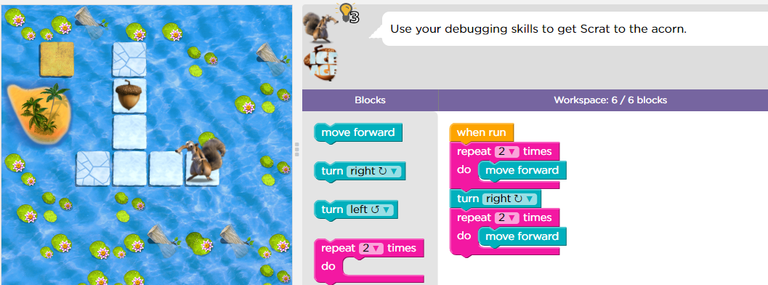

Slide 4
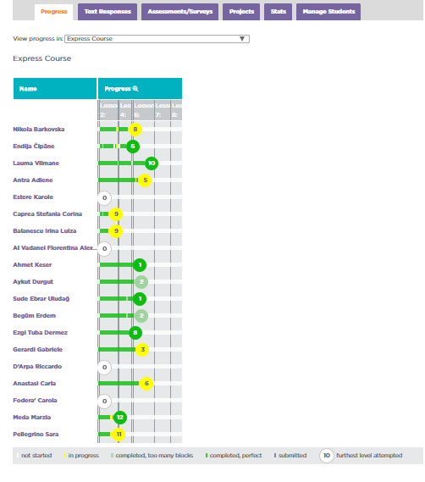

Slide 5
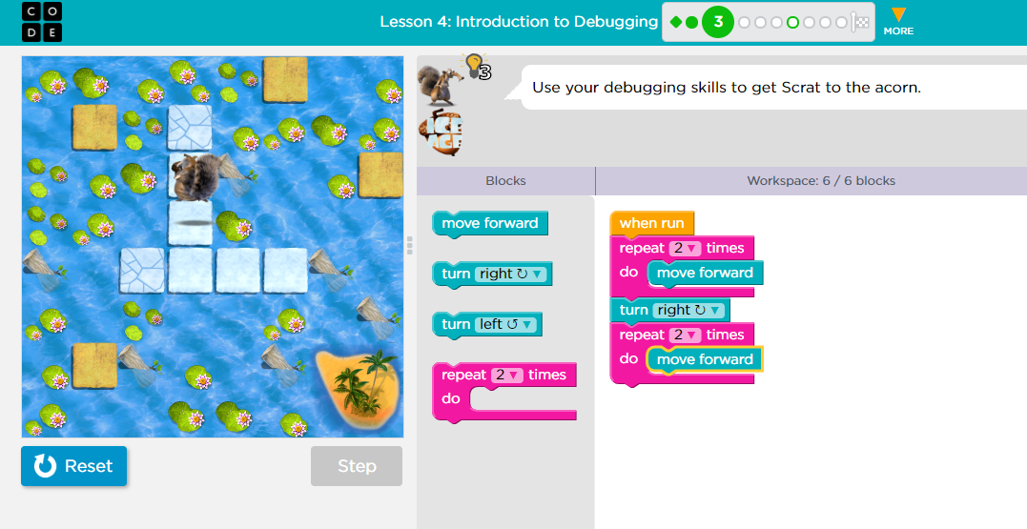

Slide 6
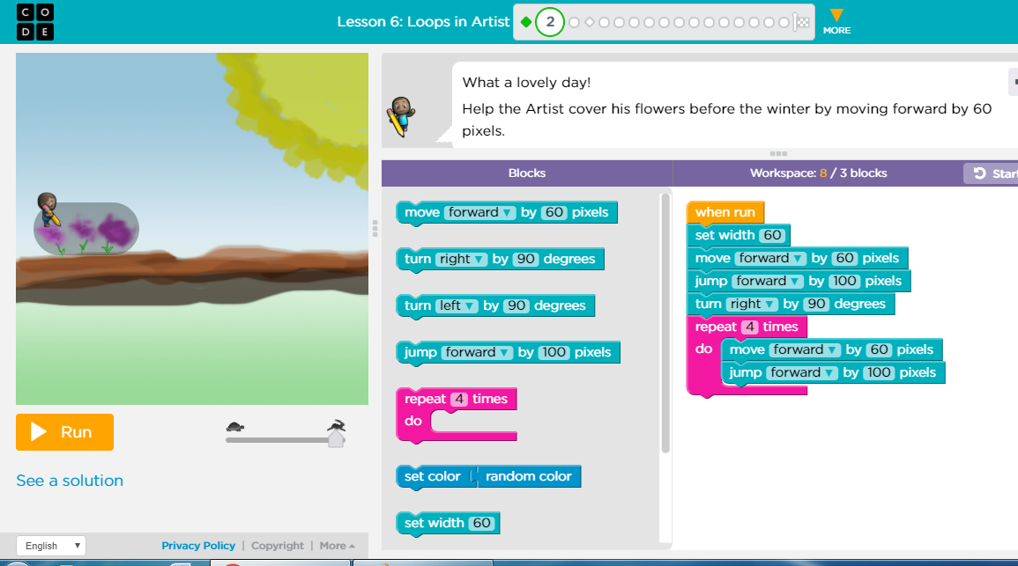

Slide 7
